Slide 1
Intuition behind Neural Networks
Nicolae Banari, Walter Daelemans

Slide 2
Content
Introduction to deep neural networks and PyTorch:
Linear models with PyTorch
Layered (deep) models
Training tips, convolutional neural networks
Recurrent neural networks

Slide 3
Neural Networks: Milestones
Frank Rosenblatt: Perceptron Mark 1 (1957)
Marvin Minsky and Seymour Papert “Perceptrons” (1969)
Linear separability problem
MLP: Multi-Layer Perceptrons (Backprop, Connectionism, Parallel Distributed Processing) (David E. Rumelhart, James L. McClelland) (1986)
Scalability problem: switch to k-NN, SVMs, NB, …
Deep Learning (2010 -) renaissance for NN: CNN, LSTM, word embeddings, Transformers, GPUs, TPUs
Large Language Models (2020 -): GPT, multimodality

Slide 4
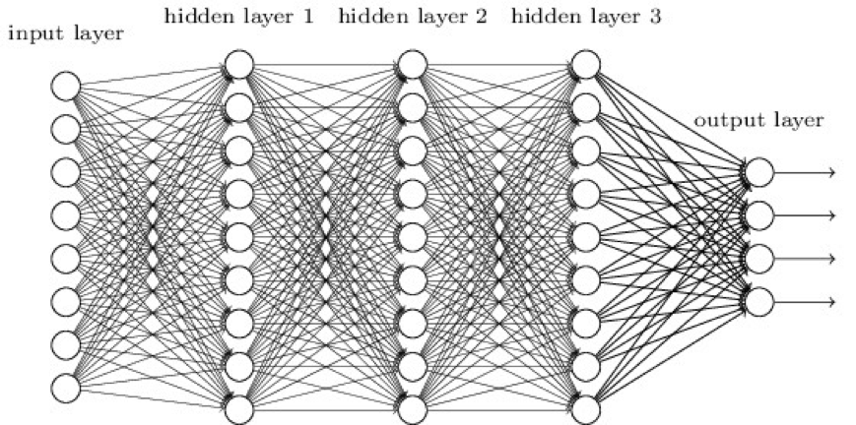
Deep Learning (Multi-Layer Perceptron)

Slide 5
Why so successful?
Availability of huge data and computing power
Significant increases of accuracy on many tasks
Representation learning is a strong idea
Pre-trained models and fine-tuning (transfer learning) is a strong idea
Different subareas of AI reuse the same techniques again
Problems:
Black box
Reasoning and common is still an issue
Highly competitive area with large dominant players

Slide 6
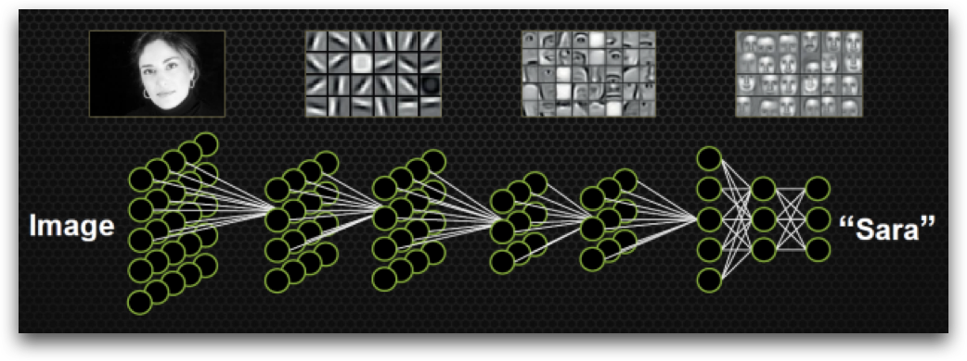
Representation learning
Importance of “layers” in computer vision. Image from here.

Slide 7
Where to find additional info?
Our course books
Coursera (a lot of good courses for beginners)
PyTorch tutorials
Kaggle

Slide 8
Today
First the (naive) intuition (slides), then the code in PyTorch
Two increasingly complex models in PyTorch:
Univariate linear regression: predicting a number from another number
Multivariate linear regression: predicting a number from many numbers
Dataset: California Housing Dataset
Homework: Wine Preferences

Slide 9

Terminology
Scalar (0D, just a number)
Vector (1D, an array / list / sequence, ...)
Matrix (2D, a table with rows and columns)
Tensor (3D or higher)
PyTorch shares many concepts with NumPy
Deep learning consists of buildings blocks (reason spatially, make drawings, etc.)

Slide 10
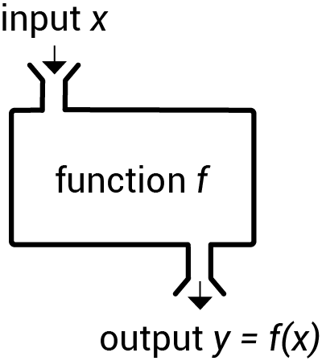
0 - Any model as a function
Any model:
Given an input X and parameters Θ, we predict output Ŷ: f(Θ, X) -> Ŷ
We want Ŷ (predictions) to be close to Y (ground-truth)
What is the optimal Θ? It’s that Θ for which difference/distance/loss between Ŷ and Y is minimal
Linear model: x * w + b = y:
one input variable x
one output variable y
set of parameters Θ = {w, b}

Slide 11
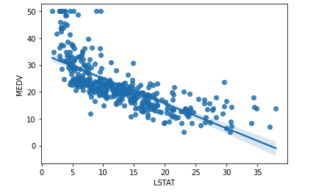
1 - Univariate linear regression
One scalar -> one scalar
w, b
Linear model assumes that we can model the relation between an input and output with a straight line, with a single coefficient or parameter (w), including a bias (b), to take care of the intercept (offset).
Model: x * w + b -> ŷ
Such a regression task (outputting a scalar) is easily turned into a (binary) classification task (outputting a class) by applying activation function (later!) a critical threshold: e.g. if ŷ >= 0.5, we output class B, else class A.
x
ŷ

Slide 12
2 - Multivariate linear regression
Many scalars -> one scalar
Often, we’ll have more than one value to predict a house’s price. Mathematically, if you understand the dot product, nothing much changes. Each feature x_{i} in x (vector of features) , gets its own weight w_{i} in w (vector of weights) . The outcomes of every x_{i} • w_{i} get summed to get the final output.
Mathematically, that’s dot-product: x • w
Often, a bias b is added: x • w + b -> ŷ, but b will also be a vector (in case of multiple outputs)
x₀
“area”
w₀
b
x₂
w₁
Σ
ŷ
“year”
“Price”
x₃
w₂
“altitude”

Slide 13
Always: X * W + b (but the shapes shift)
Univariate linear
regression
Multivariate linear
regression
input
x
x₀
x₁
x₂
w
w₀
w₁
w₂
parameters
b
b
output
ŷ
ŷ

Slide 14
3 - Multivariate multiclass logistic regression
Many scalars -> many scalars (that represent classes)
Suppose we want to classification instead of regression (“cheap” vs “expensive” >< actual price).
Simple: each class gets its own “perceptron”!
Now:
ŷ becomes a vector!
b becomes a vector!
W becomes a matrix!
x₀
w_{0, 0}
“area”
b₀
“Cheap”
w_{0, 1}
Σ
ŷ₀
x₁
w_{1, 0}
b₁
“year”
w_{1, 1}
Σ
ŷ₁
w_{2, 0}
x₂
“Expensive”
“altitude”
w_{2, 1}

Slide 15
Always: X * W + b (but the shapes shift)
Univariate linear
regression
Multivariate linear
regression
Multivariate multiclass logistic regression
input
x
x₀
x₁
x₂
x₀
x₁
x₂
w_{0, 0}
w_{0, 1}
w_{0, 2}
w
w₁
w₂
w₃
w_{1, 0}
w_{1, 1}
w_{1,2}
parameters
b
b
b₀
b₁
output
ŷ
ŷ
ŷ₀
ŷ₁

Slide 16

This is hard (we know!), but once you fully understand this, the rest is like playing with Lego.
The shapes of stuff like W, Y, b and y explain how you can stack blocks

Slide 17
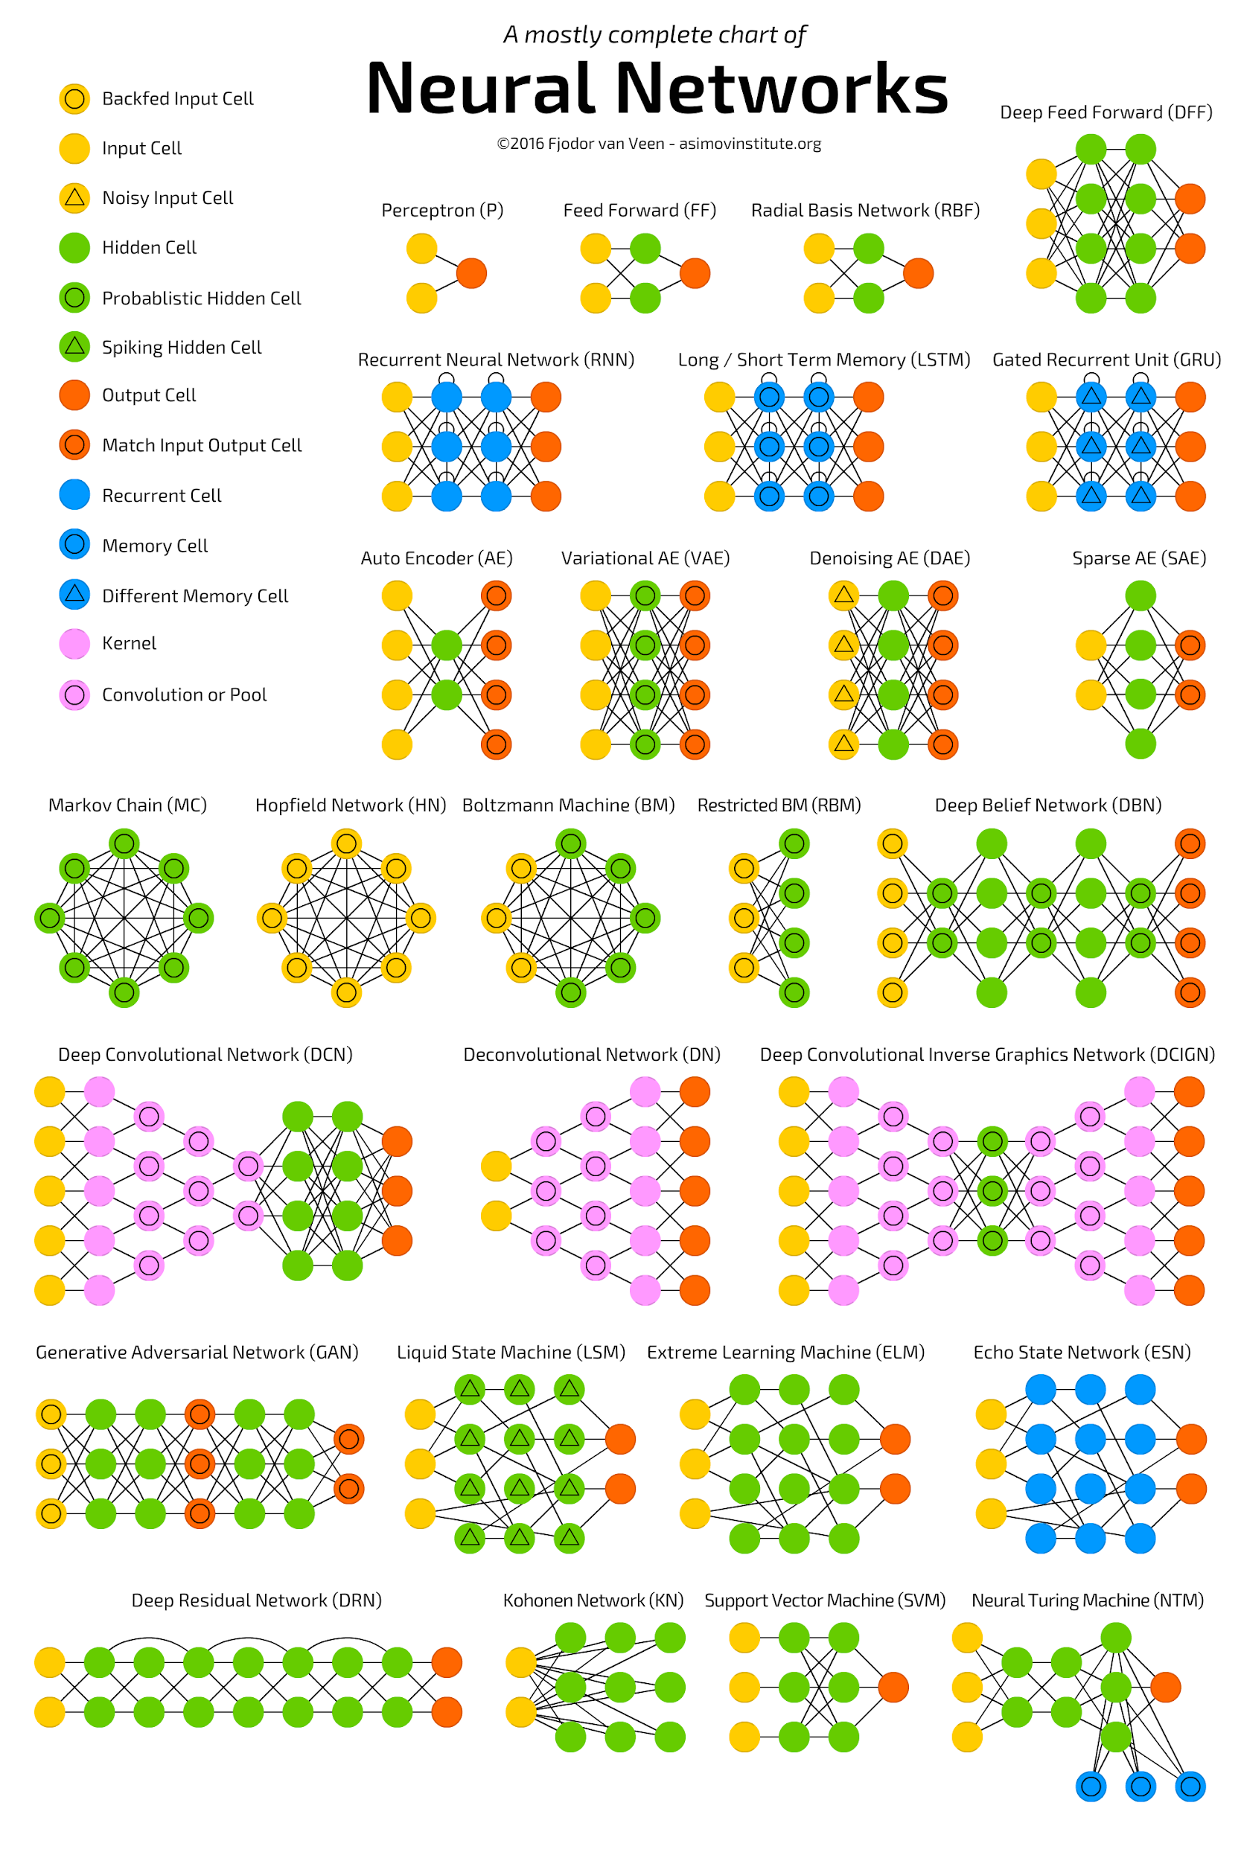
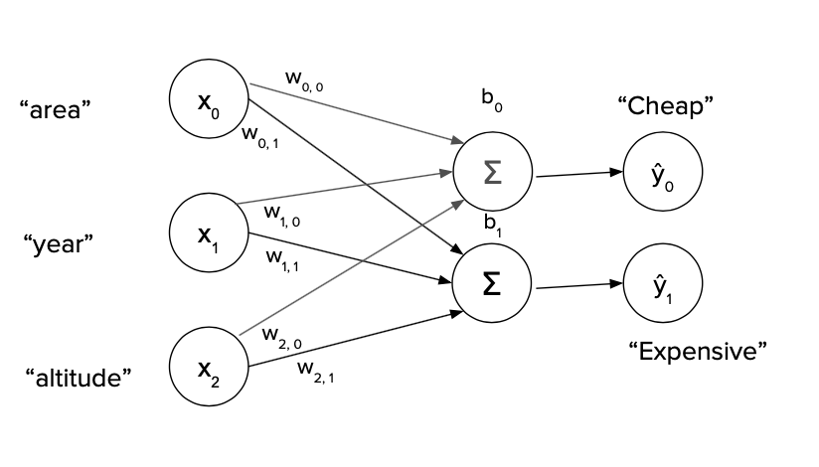
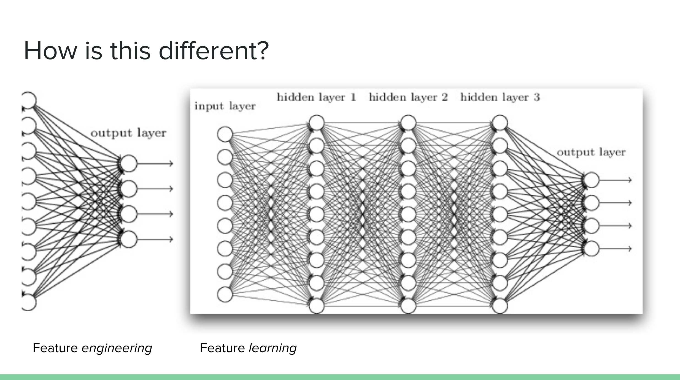
Many names of the same concept:
Dense layer
Affine transformation
Linear projection
Multilayer perceptron:
Non-linearity can be added after each neuron (aka activation function)
Multilayer perceptron is just a “stack” of these layers

Slide 18
“Forward” pass
What we’ve covered so far is called the forward pass: the calculation, how the networks transforms (maps) the input to the output
We don’t know yet how the parameters of the network (W, b) get optimized. They get initialized randomly and then get better over training.
“Backward pass” refers to calculating changes in weights (gradients) using optimization techniques for neural networks, namely, gradient descent (or variations of it). What’s that about?
We’ll start with an intuitive metaphor

Slide 19

Going down to a village in the lowlands
You hiked in the mountains. It became foggy and you can not see through the fog.
How to get back to the village? You can all do this intuitively step by step!

Slide 20
Going down to a village in the lowlands
You are at random point (just like neural network)
You can assume that if you go down you will reach the village (or get stuck in the local minima)
You can assume the direction (or angle) of descending (it is almost gradient)
Make a step in the chosen direction
Repeat!
Objective: minimize the loss; Convergence: finding the optimum (minimum) in the loss curve (and stay there!); Learning rate: a step towards minimum.

Slide 21
Gradient descent
We have a surface like mountain
We calculate the right direction to descend (Which direction? Determined by gradients)
We make a small step in the right direction (How small? Determined by learning rate)
Loss is like elevation, and parameters (w, b) are coordinates: if we make a step towards minima, we change our coordinates to better ones. Hence, in the end, you will find the best coordinates (parameters) with the lowest elevation (loss).
Loss for a model with 2 parameters (w, b)

Slide 22
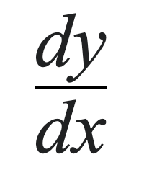
Gradients: simple, slow way vs fast, clever way
Simple, slow way
w - 𝛿
w + 𝛿
Calculate both and pick the direction (+ vs -) that minimizes the loss. Works (obviously) but requires two calculations (for every parameter!)
Fast, clever way
Use the mathematical concept of a partial derivative to find out in which direction the curve “goes down”. Equivalent, but one calculation!
“What are changes in y caused by x?”
The partial derivatives are called “gradients” (cf. skiing down or descending the hill of a loss surface)

Slide 23



“But I don’t know how to do derivatives?!”
That’s ok: there is autodifferentiation now
Deep learning has libraries or frameworks that compute the gradients for you (as crucial as hardware and datasets for success)
You just specify the “forward” function, the framework does the rest
The “backward step”: how does each parameter influence the loss?
“Partial” derivative:
derivative is calculated for each parameter separately (without e.g. taking interactions into account)
Crazy that it works (but crucial to work with small updates)

Slide 24
Take home message
Neural networks consist of blocks with shapes: if shapes match, blocks can be stacked
Parameters of a network are initialized randomly; they get updated in the light of an objective (typically minimizing a loss)
Gradient descent: each parameters gets updated in isolation by taking a small step in the right direction. (The gradient / partial derivatives tells us which direction that is for each individual parameter)

